Slide 1
FOBISIA MUN 2014
Preparatory Guidelines for all Student Chairs

Slide 2
General
All Delegations must be present during all roll calls
There will be 6 committees in FOBISIA MUN 2014: Security Council, Disarmament, Legal, Human Rights, ECOSOC, Environment.
Each will be chaired by two chairs: a President and a Co-Chair.
During voting procedures at least 2/3 of the delegate population needs to be present in the room
A majority, no matter how small the difference, is needed for a resolution to pass
Security Council is different (please look at other slide)

Slide 3
Definition of Key Terms
The House The delegation of students
The Chair The ones who chair the debate
The Main- Submitter The main submitter of a resolution. Reads out operative clauses and gives first speech.
The Co-Submitter A maximum of two co-submitters are allowed. Helped the Main-Submitter to write the resolution.
The Co-Sponsors A maximum of 6. Co-sponsors do not need to agree with the resolution. They only want to see it debated.
To have the floor A delegate can go to the podium and speak.
To yield the floor A delegate can yield to the chair or another delegate. Yields to the second degree are not allowed in FOBISEA MUN 2014.
Points e.g. POI (points of information)
Motions Raised by a delegate (e.g. motion to divide the house)
Quorum Every member in a committee

Slide 4
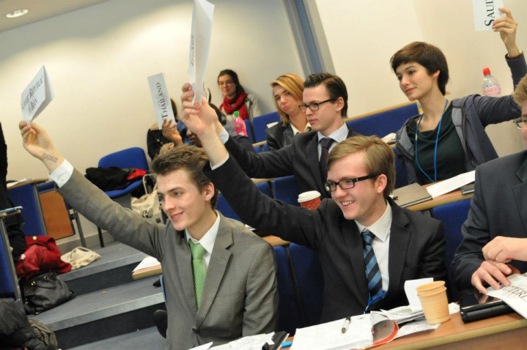
Points
Only these points can be entertained:
Point of Personal Privilege
Point of Order
Point of Information to the Speaker
Point of Information to the Chair
Point of Parliamentary Enquiry

Slide 5
Motions
Remember that Chairs can overrule any motion set forth
Motions that Delegates can make:
Motion to Move to the Previous Question
Motion to Adjourn Debate/Table a Resolution
Motion to Reconsider a Resolution
Motion to Refer a Resolution to Another Forum
Motion to withdraw resolution (do not entertain)
Motion to Extend Debate Time
Motion to Divide the House
Motion to appeal the decision of the chair (do not entertain)

Slide 6
Security Council
Made up of the 15 SC member nations
In security council, at least 9 votes are needed for a clause and a resolution to pass.
Go topic by topic. So only three resolutions will come out of the Security Council at the end.
Open debate time set for all clauses to be submitted. Once all clauses have been debated then set open debate time on the resolution as a whole.
Each member nation may only submit a maximum of 2 clauses per topic. No co-submitters and a maximum of 3 co-sponsors.
If a P5 member nation votes against a clause it is seen as a veto threat and that nation can call for a P5 caucus. If a P5 member votes against a resolution, then the resolution automatically fails.
If there is a motion to divide the house, abstentions are still allowed but voting needs to be taken by role call and not through the counting of placards.
A final resolution will have no pre-ambulatory clauses. Only operative clauses with the main-submitter labeled above.

Slide 7
Veto Threats (Security Council only)
when 1 of the P5 countries (China, UK, USA, Russia or France) feels that passing a clause will lead to their veto of the whole resolution they may issue a veto threat
Chairs will announce the veto threat if one of the P5 nations sends a note to the Chairs. They must send a note in first and not just vote against the clause.
Highly Discouraged
Veto a resolution, place a veto threat on a clause
Usually precedes a P5 Caucus

Slide 8
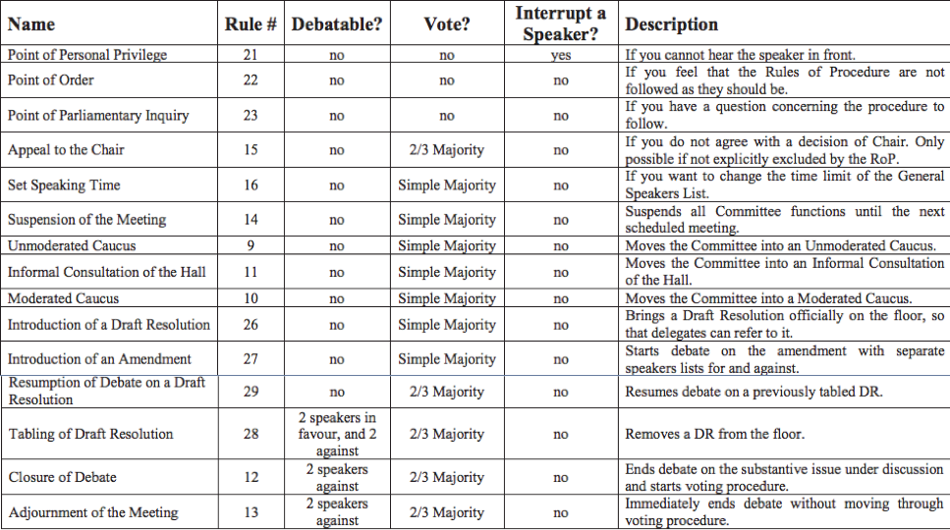
Summary

Slide 9
Speeches
Delegates may not use first and second pronouns (I, me etc.). They should refer themselves and others in 3rd person at all times.
SPEECH
Yielding
POIs
POIs
Another Delegate
Chair
POIs have to be concise in question format
One follow up granted
No direct conversation between delegates
Delegated can refuse the yield
May yield only if they have time remaining
A yield cannot be yielded again
Floor is Open for points, motions, or speeches

Slide 10
Preambulatory Clauses
Perambulatory Clauses
Make up the first half of the resolution
Not to be debated on or read out
The Chair will check whether there are any objection to any perambulatory clauses after all the operative clauses have been debated
Defines and recognizes the issue and its importance
Eg:
Aware that the trade of illicit arms and light weapons in Africa is a global enterprise,

Slide 11
Operative Clauses
Operative Clauses
Indicate what action a resolution calls for
Methods for solving the problem at hand
Eg:
Strongly urges that all member states to implement trade embargoes on the aforementioned countries;

Slide 12
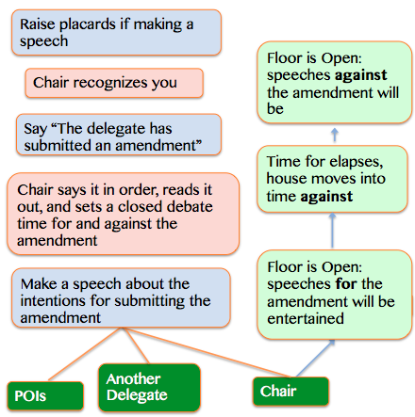
Amendments
Raise placards if making a speech
Chair recognizes you
Floor is Open: speeches against the amendment will be
Say “The delegate has submitted an amendment”
Chair says it in order, reads it out, and sets a closed debate time for and against the amendment
Time for elapses, house moves into time against
VOTE
Make a speech about the intentions for submitting the amendment
Floor is Open: speeches for the amendment will be entertained
Motion to move to previous question
POIs
Another Delegate
Chair

Slide 13
Amendments
Delegates may yield the floor to other Delegations (but only once)
Amendments to the 1st & 2nd degree are in order
Amendments must be submitted to the Chair on official amendment paper in legible handwriting
Amendments will be entertained if the speaker who has the floor moves the amendment
Amendments will be debated in closed debate style (time set for and time set against)
Voting is compulsory (they may abstain unless the house is to be divided…except for the security council which works differently)
Delegations may vote in favor, against, or abstain from voting on resolutions or amendments
Non-member Delegations or NGOs may not vote
All amendments need to be taken down in an amendment log

Slide 14
Dress Code
Men must wear a jacket and tie at all times when addressing the committee (both POIs and speech)
Women must be appropriately dressed and respectful of Brunei’s culture. No skirts above the knee.
National and cultural attire are strictly prohibited
Delegates must wear their badges at all times

Slide 15
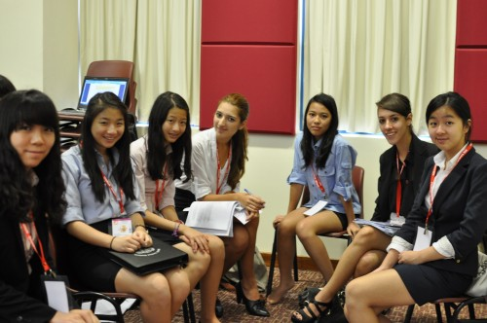
Lobbying & Merging
All Delegations must be active during lobbying
Laptops are permitted during lobbying
Main-submitters must ensure that the co-submitter/co-sponsor sheet is filled before presenting the resolution to the Chairs
Each resolution much have co-sponsors (maximum 6)
Each Resolution must have a co-submitter (maximum 2). No lone rangers!

Slide 16
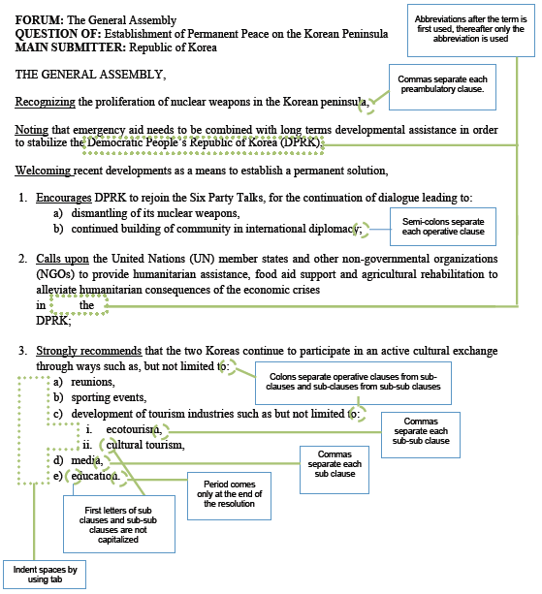
Resolution Format
Note that for perambulatory clauses the first word should be underlined and italicized. For operative clauses the first word need only be underlined.

Slide 17
Resolutions
Draft resolution (soft copy) and co-submitter sheet is submitted to the Chairs
Chair validates resolution and saves edited resolution on pen drive of Main Submitter
Main Submitter to take soft copy on their USB to the admin who will send it to the approval panel. Once approved it is to be printed out and photocopied.
Chair will arrange debating time for each resolution spreading out per topic.
Admins will prepare resolution for debate and hand out at given time.

Slide 18
Plagiarism
“To copy another person’s ideas, words or work and pretend that they are your own”
- Oxford Dictionary
Just don’t do it.

Slide 19
General Rules during Debating
Active laptops are not permitted during debate
Cameras with flash are not permitted
Mobile phones are not permitted
Be punctual at all times
Respect and appreciate Admin Staff
No illegal activities inside Jerudong International School Campus.

